Slide 1


Machine Learning
With python
NN1: Neural Nets
perceptrons
Notes:
Layout objects pulled from: https://slidesgo.com/
All icons are from: https://thenounproject.com/

Slide 2
simple linear regression predicts a continuous target from a single feature using the prediction function ŷ = β0 + β1x
multi linear regression predicts a continuous target from more than one feature using the prediction function ŷ = β0 + β1x1 + β2x2 + … + βnxn
feature values
sum
output
x1
β1
z
ŷ
β2
x2
βn
β0
…
We call the βi values coefficients and β0 the intercept
xn
1

Slide 3

logistic regression predicts a categorical (typically binary) target from one or more features using the prediction function ŷ = σ(β0 + β1x1 + β2x2 + … + βnxn) where σ(z) is the sigmoid function
feature values
sum
squish
output
x1
β1
z
σ
ŷ
β2
x2
βn
β0
…
xn
1

Slide 4
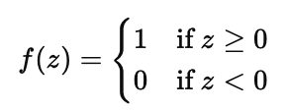
perceptron is a very simple neural network, also called linear binary classifier. Let’s update our parameter naming convention: use 𝑤1 for weights and b for bias.
Our prediction function ŷ = f(b + 𝑤1x1 + 𝑤2x2 + … + 𝑤nxn) where f(z) is what we call the activation function
feature values
sum
activation
output
x1
𝑤1
z
f
ŷ
𝑤2
x2
𝑤n
b
Our first activation function we’ll look at is the unit-step.
…
xn
1

Slide 5


perceptron is a very simple neural network, also called linear binary classifier. Let’s update our parameter naming convention: use 𝑤1 for weights and b for bias.
Our prediction function ŷ = f(b + 𝑤1x1 + 𝑤2x2 + … + 𝑤nxn) with the unit-step function
Our cost function Cost(𝑤i, b) will be the proportion of incorrect labels
predicted vs actual
ŷ
yi
ŷ = y means it was correctly predicted, thus 0
ŷ ≠ y means it was not correctly prediction, thus ±1
Usually the next step is to do gradient descent (taking derivatives) but that won’t work here. Why?
Both absolute value and unit-step functions are non-differentiable for various reasons

Slide 6
training a perceptron
stochastic gradient descent is the optimization used to minimize the cost function in neural networks by updating weights incrementally, using one data point (or a small batch) at a time
ŷ = f (b + 𝑤1x1 + 𝑤2x2 + … + 𝑤nxn)
learning rate: l
Initialize 𝑤i and b
Repeat the following until stable:
1. Pick one training example
(x1,x2, …, xn, y)
2. Compute the gradient of cost for
that example
3. Adjust 𝑤i and b in direction of
negative gradient
Initialize 𝑤1 and b
Repeat the following until stable:
1. Pick one training example
(x1,x2, …, xn, y)
2. Compute ŷ. If ŷ = y, continue.
3. If ŷ ≠ y, update:
𝑤i ← 𝑤i + l (y - ŷ)xi
b ← b + l (y - ŷ)

Slide 7

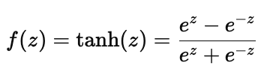
An activation function transforms the linear combination z = β0 + β1x1 + β2x2 + … + βnxn into a neuron’s final output. This non-linear transformation f(z) allows neural networks to model complex, non-linear relationships. Different activation functions f can be used depending on the task and layer type.
unit-step
sigmoid
tanh
1
1
1
z
z
z
-1
advantages
simple, allows for
binary classification
advantages
differentiable everywhere; allows for binary classification;
advantages
similar to sigmoid;
centered around 0
disadvantages
derivative DNE at z=0, 0 everywhere else
disadvantages
gradient vanishes for large or small inputs, slowing training
disadvantages
gradient vanishes for large or small inputs, slowing training

Slide 8

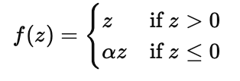
An activation function transforms the linear combination z = β0 + β1x1 + β2x2 + … + βnxn into a neuron’s final output. This non-linear transformation f(z) allows neural networks to model complex, non-linear relationships. Different activation functions f can be used depending on the task and layer type.
relu
leaky relu
most commonly used
ɑ = 0.5
z
z
advantages
if z>0, gradient never 0;
fixes vanishing gradient
advantages
solves dying ReLU
disadvantages
dying ReLU: if z<0,
derivative DNE
disadvantages
lacks symmetry

Slide 9
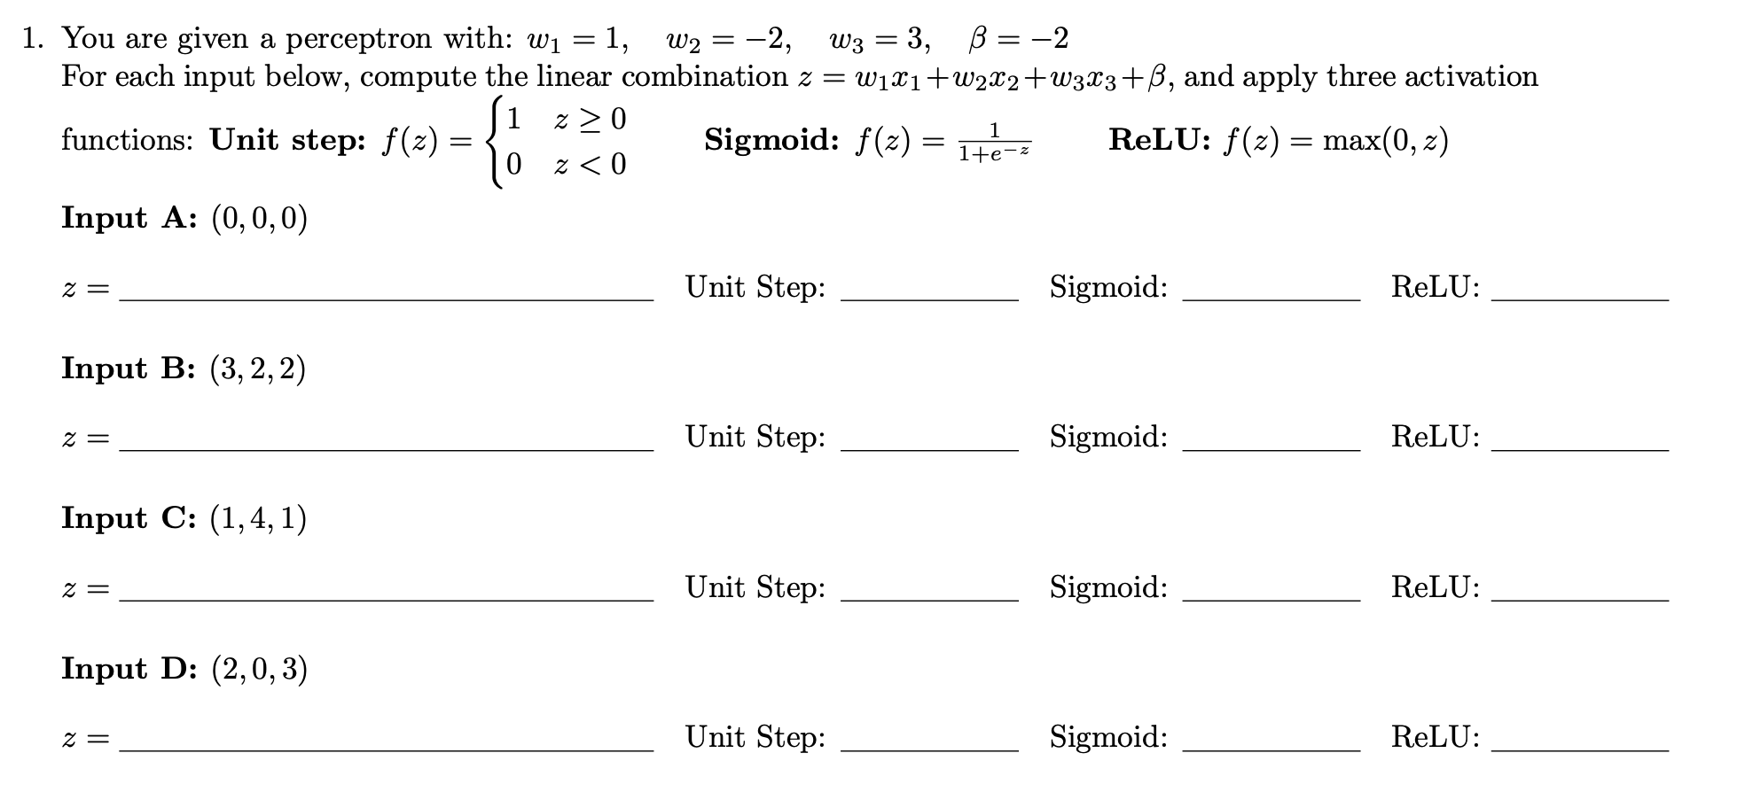

HW9#1
Try to answer the following questions

Slide 10
A small neural network for a binary classifier with four inputs and one hidden layer
input layer
hidden layer
output layer
x1
z
h
x2
z
h
z
x3
z
h
x4
1
1

Slide 11
Machine Learning
With python
NN2: Neural Nets
architecture
Notes:
Layout objects pulled from: https://slidesgo.com/
All icons are from: https://thenounproject.com/

Slide 12
input values
X = (x1,x2, …, xn)
values at first hidden layer, after activation
h ⁽¹⁾ = (h₁⁽¹⁾, h₂⁽¹⁾, h₃⁽¹⁾)
values at second hidden layer, after activation
h ⁽²⁾ = (h₁⁽²⁾, h₂⁽²⁾)
output value;
prediction ŷ
input layer
hidden layer 1
hidden layer 2
output layer
x1
z
h
z
h
x2
z
h
z
x3
z
h
z
h
x4
values at first hidden layer, before activation
Z ⁽¹⁾ = (Z₁⁽¹⁾, Z₂⁽¹⁾, Z₃⁽¹⁾)
values at second hidden layer, before activation
Z ⁽²⁾ = (Z₁⁽²⁾, Z₂⁽²⁾)
b⁽¹⁾
b⁽²⁾
b⁽³⁾

Slide 13
h ⁽¹⁾ = (h₁⁽¹⁾, h₂⁽¹⁾, h₃⁽¹⁾)
w_{i,j}⁽¹⁾ is the weight of connection from input layer j to neuron i at hidden layer 1
X = (x1,x2, …, xn)
Z ⁽¹⁾ = (z₁⁽¹⁾, z₂⁽¹⁾, z₃⁽¹⁾)
b_{i}⁽¹⁾ is the bias of neuron i at hidden layer 1
input layer
hidden layer 1
x1
w_{1,1}⁽¹⁾
z₁⁽¹⁾ = w_{1,1}⁽¹⁾ x1 + w_{1,2}⁽¹⁾ x2 + w_{1,3}⁽¹⁾ x3 + w_{1,4}⁽¹⁾ x4 + b₁⁽¹⁾
z₁⁽¹⁾
h₁⁽¹⁾
z₂⁽¹⁾ = w_{2,1}⁽¹⁾ x1 + w_{2,2}⁽¹⁾ x2 + w_{2,3}⁽¹⁾ x3 + w_{2,4}⁽¹⁾ x4 + b₂⁽¹⁾
x2
z₃⁽¹⁾ = w_{3,1}⁽¹⁾ x1 + w_{3,2}⁽¹⁾ x2 + w_{3,3}⁽¹⁾ x3 + w_{3,4}⁽¹⁾ x4 + b₃⁽¹⁾
z₂⁽¹⁾
h₂⁽¹⁾
w_{1,1}⁽¹⁾ w_{1,2}⁽¹⁾ w_{1,3}⁽¹⁾ w_{1,4}⁽¹⁾
x1
x2
x3
x4
b₁⁽¹⁾
b₂⁽¹⁾
b₃⁽¹⁾
x3
=
w_{2,1}⁽¹⁾ w_{2,2}⁽¹⁾ w_{2,3}⁽¹⁾ w_{2,4}⁽¹⁾
+
z₃⁽¹⁾
h₃⁽¹⁾
w_{3,1}⁽¹⁾ w_{3,2}⁽¹⁾ w_{3,3}⁽¹⁾ w_{3,4}⁽¹⁾
x4
w_{3,4}⁽¹⁾
b₃⁽¹⁾
bias vector
Z⁽¹⁾
=
W⁽¹⁾
+
b⁽¹⁾
X
b⁽¹⁾
matrix of weights

Slide 14
h₁⁽¹⁾
h₂⁽¹⁾
h₃⁽¹⁾
ɸ ⁽¹⁾( z₁⁽¹⁾ )
ɸ ⁽¹⁾( z₂⁽¹⁾ )
ɸ ⁽¹⁾( z₂⁽¹⁾ )
ɸ ⁽¹⁾: activation function at first hidden layer
=
h⁽¹⁾ = ɸ ⁽¹⁾( Z⁽¹⁾)
ɸ ⁽²⁾: activation function at first hidden layer
applied componentwise
input layer
hidden layer 1
hidden layer 2
output layer
ɸ ⁽¹⁾
ɸ ⁽²⁾
x1
z
h
z
h
x2
z
h
z
x3
z
h
z
h
x4
b⁽¹⁾
Z ⁽¹⁾
h ⁽¹⁾
b⁽²⁾
Z ⁽²⁾
h ⁽²⁾
b⁽³⁾
prediction ŷ

Slide 15
Forward computation (making predictions)
Z⁽¹⁾ = W⁽¹⁾ X + b⁽¹⁾
Z⁽²⁾ = W⁽²⁾ h⁽¹⁾ +b⁽²⁾
Z⁽³⁾ = W⁽³⁾ h⁽²⁾ +b⁽³⁾
h⁽¹⁾ = ɸ ⁽¹⁾( Z⁽¹⁾)
h⁽²⁾ = ɸ ⁽²⁾ (Z⁽²⁾)
ŷ = ɸ ⁽³⁾ (Z⁽³⁾)
input layer
hidden layer 1
hidden layer 2
output layer
ɸ ⁽¹⁾
ɸ ⁽²⁾
ɸ ⁽³⁾
x1
z
h
z
h
x2
z
h
z
x3
z
h
z
h
x4
X
Z ⁽¹⁾
h ⁽¹⁾
b⁽²⁾
Z ⁽²⁾
h ⁽²⁾
b⁽³⁾
Z ⁽³⁾
prediction ŷ
b⁽¹⁾

Slide 16
For gradient descent, we need to compute the derivatives
and where C is the cost function
So how to do this? Well we start at the end of our network and work backwards using the chain rule
𝛿C
𝛿Wij^{(k)}
𝛿C
𝛿bi^{(k)}
input layer
hidden layer 1
hidden layer 2
output layer
ɸ ⁽¹⁾
ɸ ⁽²⁾
ɸ ⁽³⁾
x1
z
h
z
h
x2
z
h
z
x3
z
h
z
h
x4
X
b⁽¹⁾
Z ⁽¹⁾
h ⁽¹⁾
b⁽²⁾
Z ⁽²⁾
h ⁽²⁾
b⁽³⁾
Z ⁽³⁾
prediction ŷ

Slide 17
backpropagation
For gradient descent, we need to compute the derivatives and
The cost C is a function of the predicted value y according to some loss function ℒ
Predicted y is a function of all weights and biases
𝛿C
𝛿Wij^{(k)}
𝛿C
𝛿bi^{(k)}
Z⁽¹⁾ = W⁽¹⁾ X + b⁽¹⁾
h⁽¹⁾ = ɸ ⁽¹⁾( Z⁽¹⁾)
𝛿C
𝛿W⁽³⁾
𝛿C
𝛿y
𝛿y
𝛿 Z⁽³⁾
𝛿Z⁽³⁾
𝛿 W⁽³⁾
𝛿C
𝛿y
(ɸ ⁽³⁾ )′
h⁽²⁾
=
=
Z⁽²⁾ = W⁽²⁾ h⁽¹⁾ +b⁽²⁾
𝛿C
𝛿b⁽³⁾
𝛿C
𝛿y
𝛿y
𝛿 Z⁽³⁾
𝛿Z⁽³⁾
𝛿 b⁽³⁾
𝛿C
𝛿y
(ɸ ⁽³⁾ )′
=
=
h⁽²⁾ = ɸ ⁽²⁾ (Z⁽²⁾)
Z⁽³⁾ = W⁽³⁾ h⁽²⁾ +b⁽³⁾
𝛿C
𝛿W⁽²⁾
𝛿C
𝛿y
𝛿y
𝛿 Z⁽³⁾
𝛿Z⁽³⁾
𝛿 h⁽²⁾
𝛿h⁽²⁾
𝛿 Z⁽²⁾
𝛿Z⁽²⁾
𝛿 W⁽²⁾
𝛿C
𝛿y
(ɸ ⁽³⁾ )′
W⁽³⁾(ɸ ⁽²⁾ )′
h⁽¹⁾
=
=
ŷ = ɸ ⁽³⁾ (Z⁽³⁾)
𝛿C
𝛿b⁽²⁾
𝛿C
𝛿y
𝛿y
𝛿 Z⁽³⁾
𝛿Z⁽³⁾
𝛿 h⁽²⁾
𝛿h⁽²⁾
𝛿 Z⁽²⁾
𝛿Z⁽²⁾
𝛿 b⁽²⁾
𝛿C
𝛿y
(ɸ ⁽³⁾ )′
W⁽³⁾(ɸ ⁽²⁾ )′
=
=
C = ℒ(ŷ)
Note: I’m fudging some of the math here for illustrative purposes
You can see that these chains are getting longer and longer… this is where the vanishing gradient comes into play

Slide 18
If an activation function has zero derivative later in the network, early neurons will have 0 for their partials
Vanishing Gradient Problem
For deep networks, we get really long chains:
𝛿C
𝛿W^{(j)}
𝛿C
𝛿y
(ɸ ^{(k)} )′
W^{(k)}(ɸ ^{(k-1)} )′
W^{(k-1)}(ɸ ^{(k-2)} )′
…
(ɸ ^{(j)} )′
h^{(j)}
=
meaning the beginning of the network stops learning
Why is this an issue?
How to fix it
Limited learning capacity
Struggles with long-term dependencies
Architectural constraints
Slow, unstable training
Numerical underflow from repeated small gradients
Vanishing step sizes toward minima
Shallow layers learn more than deeper ones, limiting model depth
Activation function selection
Initialize weights & biases: (weights are the identity matrix; bias are all 0)
Gates: used in NN algorithms like LSTM and GRU where each layer has gates that control the flow of information. Drops irrelevant info (forget), stores relevant (store), filters it (update), then uses it in conjunction with backpropagation (output)

Slide 19
By changing the structure of the output layer, we can construct neural networks to do many tasks:
Predict continuous target in the real numbers (regression)
Predict ordinal target in the integers
Predict binary target either 0 or 1 (binary classification)
Predict categorical target with 3+ classes (multiclass classification)
Lots more! Can also use text and images for classification or generation (we’ll see more of this during deep learning)
output layer
Z ^{(k)}
ŷ

Slide 20
If only one neuron in the last layer, then Z ^{(k)} is a real number
output layer
Predict continuous target in the real numbers (regression)
ŷ = Z ^{(k)}
Z ^{(k)}
ŷ
Predict ordinal target in the integers
ŷ = round( Z ^{(k)} )
Note: likely would use real number + MSE for training

Slide 21
If only one neuron in the last layer, then Z ^{(k)} is a real number
output layer
Predict binary target either 0 or 1 (binary classification)
First option: use unit-step function for ɸ ^{(k)}
ŷ = ɸ ^{(k)}( Z ^{(k)} )
Second option (more common): use sigmoid function for ɸ ^{(k)}
ŷ = round( ɸ ^{(k)}( Z ^{(k)} ) )
Z ^{(k)}
ɸ ^{(k)}
ŷ

Slide 22
Z ^{(k)} is now (Z₁^{(k)},Z₂^{(k)},Z₃^{(k)}, ... ,Z_{C}^{(k)})
output layer
Predict categorical target with 3+ categories (multiclass classification)
If there are C classes, then the output layer has C neurons where each is a binary classifier for a single class. The activation function ɸ ^{(k)} is the sigmoid function.
ŷ = argmax( ɸ ^{(k)}( Z ^{(k)} ) )
this selects the class with the largest output to be the predicted class
ɸ ^{(k)}
Z₁^{(k)}
Z₂^{(k)}
ŷ
…
Z_{C}^{(k)}

Slide 23
other output layer architectures
for image generation, the output layer has a neuron for each pixel
for text generation, the output layer has a neuron for each word or letter
training optimization
decrease learning rate for each epoch/example
use regularization: add term to cost function to penalize large values for weights/biases; helps with overfitting

Slide 24
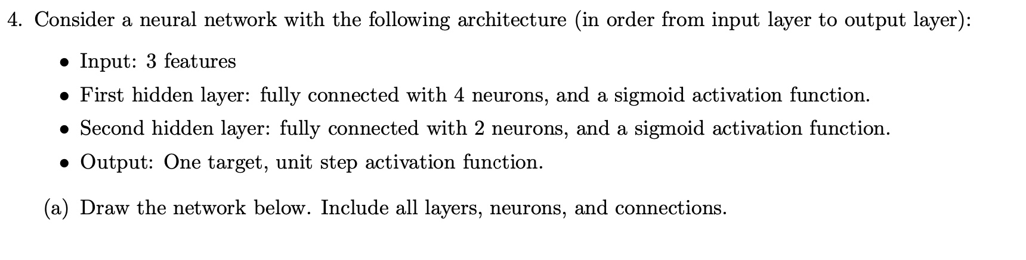
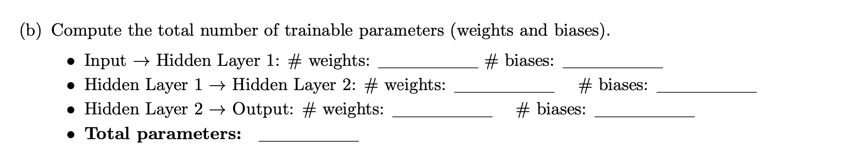
HW9#4

Slide 25
Machine Learning
With python
NN2.5: Neural Nets
some interesting applications
Notes:
Layout objects pulled from: https://slidesgo.com/
All icons are from: https://thenounproject.com/

Slide 26

Let’s see an example with pens and pencils (click link)

Slide 27

exercise
Try out Teachable Machine for yourself. Here are some ideas for inspiration:
Use video capture to take a bunch of selfies of happy and angry faces
Use photo upload to determine whether a new image is a cat or a dog
Use audio feature to record claps and snaps
Grab audio files from the internet of 2+ musical genres
Take videos of yourself doing heads-shoulders-knees-toes (each own class)
There are also tutorials on the website you can try out too. They are published on Medium (paid service), but you can read 1-2 articles for free each month

Slide 28
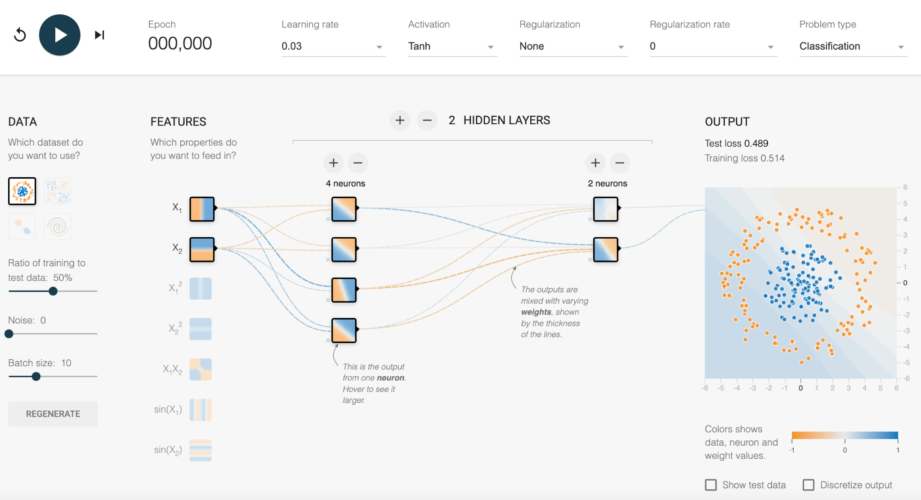
tensorflow neural net playground
For one of the datasets modify the hidden layer so that tanh activation does not find a solution, but ReLU does!

Slide 29
Machine Learning
With python
NN3: Neural Nets
workflow
Notes:
Layout objects pulled from: https://slidesgo.com/
All icons are from: https://thenounproject.com/

Slide 30
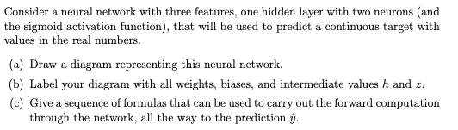
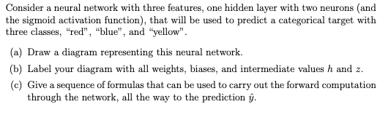

Slide 31
Colab workbook
Link: click for access

Slide 32
warm-up
Let’s play some Tic-Tac-Toe! Pair up with a partner and head to a whiteboard
Play 3 rounds of Tic-Tac-Toe. The first player is always X, the second is O. Take turns being X and O so both players get a feel for each role.
Analyze: Most common opening moves? What caused wins vs ties? Any patterns to win or block a win?
Why might going first be helpful in Tic-Tac-Toe? What are some strong first moves for player X? Are any positions better than others? Can the second player O force a tie with the right strategy?
Work together to outline a basic strategy for player X that:
Maximizes the chance of winning
Accounts for different possible responses from player O
Uses observations from the games you played
Write your strategy as a step-by-step plan (e.g., "If the center is open, choose the center...").

Slide 33
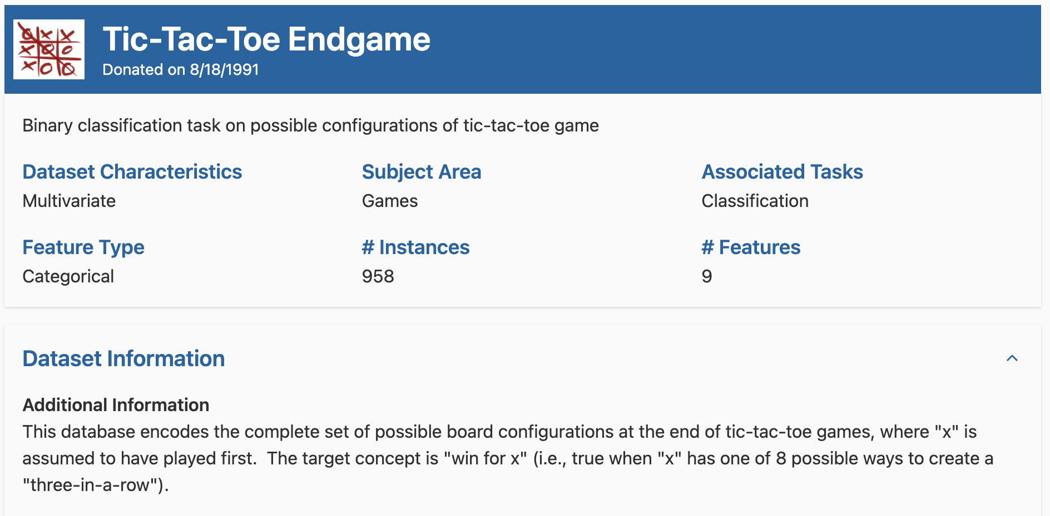
Tic Tac Toe Endgame

Slide 34
markers
board layout
target
Top Left
Top Mid
Top Right
positive class: player using x wins
Middle Left
Middle Mid
Middle Right
Negative class: player using x loses
blank
Bottom Left
Bottom Mid
Bottom Right

Slide 35
board config positive
board configuration negative
Top Left
Top Mid
Top Right
Top Left
Top Mid
Top Right
blank
Middle Left
Middle Mid
Middle Right
Middle Left
Middle Mid
Middle Right
blank
Bottom Left
Bottom Mid
Bottom Right
Bottom Left
Bottom Mid
Bottom Right
blank

Slide 36
classification metric: accuracy
binary output (win or not)
data cleaning needed to encode categorical data as numbers
ordering matters due to related squares in board state
supervised since we have a target
Tic Tac Toe Endgame

Slide 37
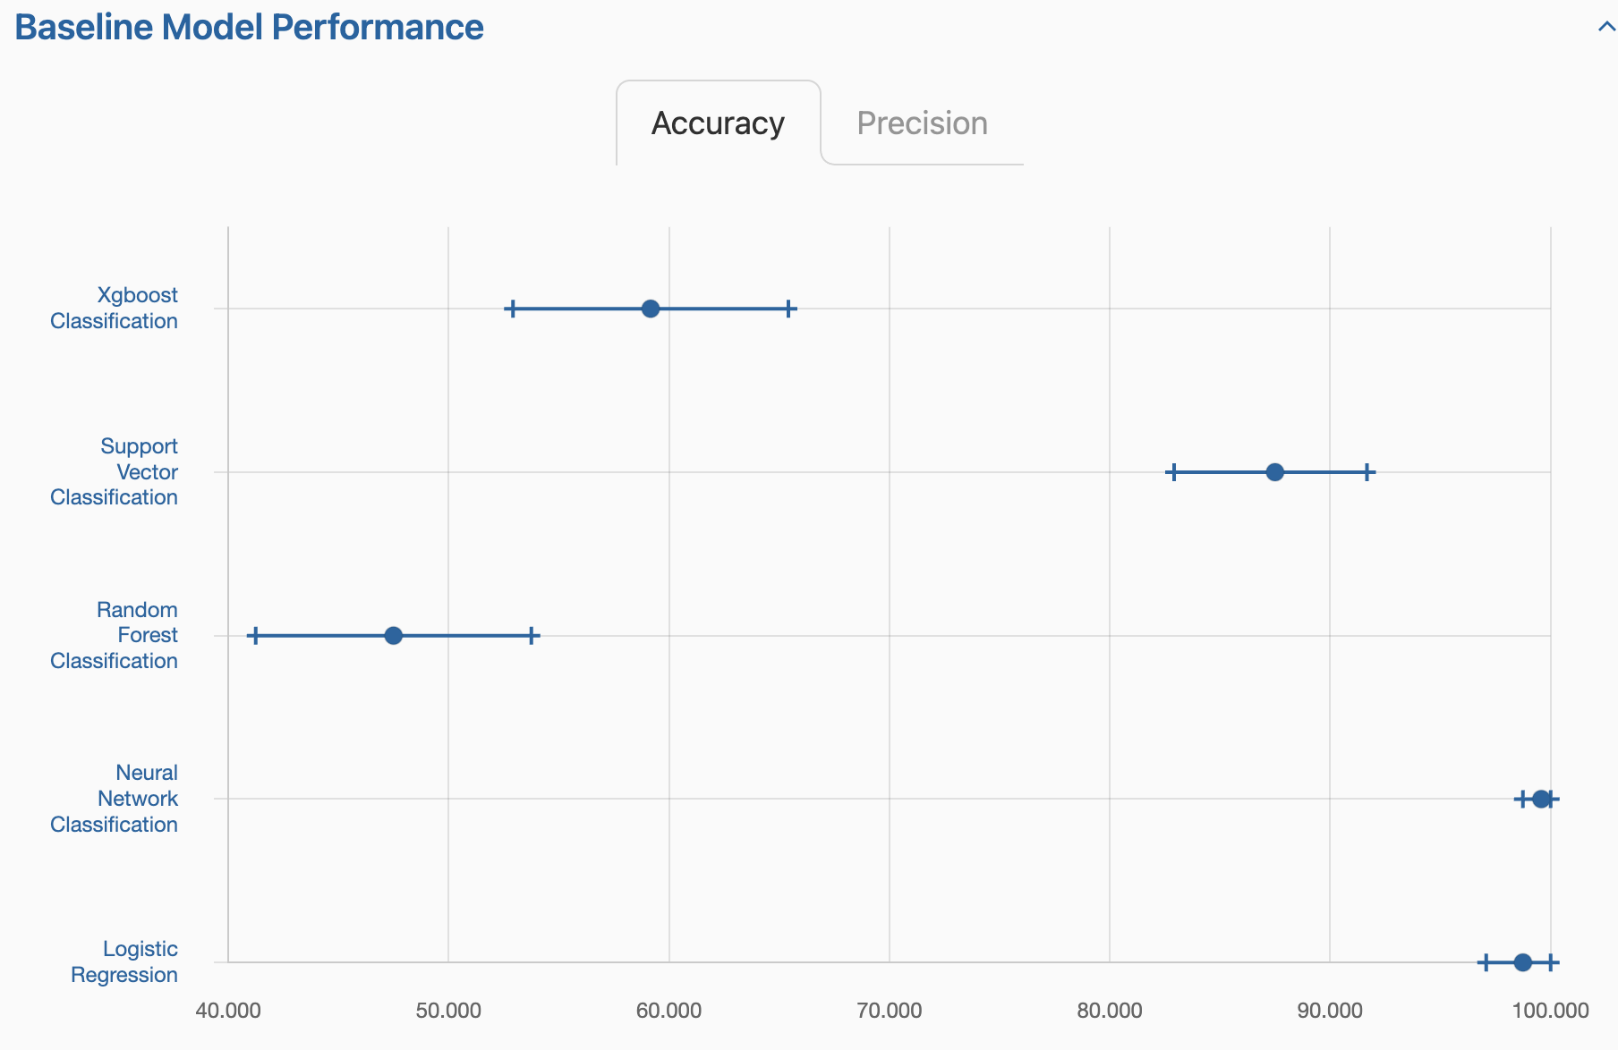
Tic-Tac-Toe is fully deterministic — there is a direct, learnable mapping from board state to win/loss
The feature space is relatively small.
There's no noise or ambiguity in the labels.
Board state is dependent on what has already happened, so feature interactions are important.
XGBoost is built for large, noisy datasets, and Tic-Tac-Toe has rigid patterns that it may miss without deep trees—leading to underfitting and overly generic predictions.
SVMs can struggle with categorical variables unless they're well-encoded
9 features with 3 values each, the dataset becomes linearly separable in this high-dimensional space (27 binary features). Each cell position matters a lot.
Random Forest doesn’t "see" higher-order feature interactions like "three Xs in a line"

Slide 38
data cleaning
Need to convert the features
and targets to numbers
markers
target
1
positive class: player using x wins
1
Last, we will want to scale the data using StandardScaler since NN are sensitive to scale
scaler = StandardScaler()
scaler.fit(X)
X = scaler.transform(X)
-1
0
Negative class: player using x loses
blank
0

Slide 39
Why this type of encoding?
Efficiency: goes from 27 (in one-hot) to 9 inputs, making models simpler and faster to train.
Signed values: It embeds meaning– positive represents player X, negative represents the opponent O, and 0 is neutral.
Weighted interactions: Some models (like neural networks or linear models) may benefit from these continuous or signed values, which allow them to learn weighted patterns more easily (e.g., "3 Xs in a row" adds to 3).
assumptions being made
Symmetry: We assume that the difference between X and O is linear and symmetric – X is just the opposite of O
Signed values: We assume the model will interpret in terms of player X that 1 is good, -1 is bad, and 0 is neutral.
Linear separability: This encoding might work well if the model can use numerical relationships to separate classes, but could hurt if more complex, nonlinear patterns are needed.
markers
1
-1
blank
0

Slide 40
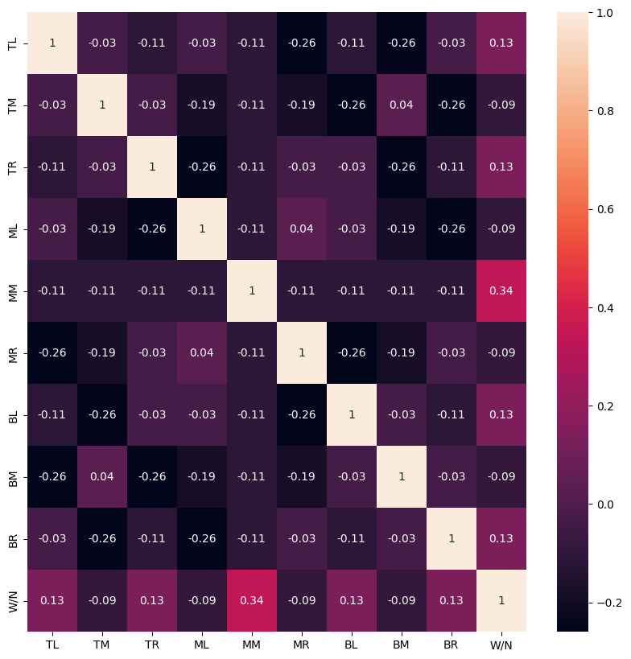
Let’s take a look at our target
Middle Mid (MM) has the highest correlation with winning at 0.34
Corners (TL, TR, BR, BL) have positive association with winning at 0.13
The cross section (TM, ML, MR, BM) has negative association with winning at -0.09

Slide 41

Open-source deep learning library from Google that uses computational graphs & tensor operations
Great for:
custom model design
GPU acceleration
production- scale models
https://www.tensorflow.org/learn

Slide 42

Open-source deep learning library from Google that uses computational graphs & tensor operations
Additional workbooks:
flower image analysis
investigating data
https://www.tensorflow.org/learn

Slide 43


simple, good for quick tests and prototyping
complex, good for deep learning and large models
limited flexibility
very flexible, GPU support

Slide 44
So what even is a tensor?
Essentially a numpy array but you can run it on GPU
Tensor attributes describe their shape, datatype, and the device on which they are stored
Created on CPU by default, can add “accelerators” to help with processing (this is where GPU comes in)
board config positive
Top Left
Top Mid
Top Right
Middle Left
Middle Mid
Middle Right
[-1, 1, -1, 1, 1, 0, 0, 1, -1]
blank
Bottom Left
Bottom Mid
Bottom Right
blank
[[-1, 1, -1],
[1, 1, 0],
[ 0, 1, -1]]
[[ o, x, o],
[ x, x, b],
[ b, x, o]]

Slide 45
Update hidden_layer_sizes to reflect the dataset we have. What are good options for sizes for a three layer network?
scikit-learn Implementation
from sklearn.neural_network import MLPClassifier
mlp = MLPClassifier(hidden_layer_sizes=(50,50,50), max_iter=500)
mlp.fit(X_train, y_train)
accuracy_score(y_test, mlp.predict(X_test))
For small dataset, keep it shallow and narrow: (10,)or (20,) or(32, 16).
In general, size is related to the number of features (input size). Try layers with size similar to or slightly larger than input size (e.g., 10 inputs → 5–20 neurons), or as some multiple

Slide 46
Let’s take a look at our workbook to walk through this one.
When we come back to this, come up with a reasoning to why the network is structured this way:
Why do we have 81 neurons in the first hidden layer?
Why do we have 2 neurons in the final layer?
What is the difference between ReLu and SoftMax activation functions (you may have to look this up)
TensorFlow Implementation
import tensorflow as tf
from tensorflow import keras
model = keras.Sequential([
keras.layers.Dense(81, activation='relu'),
keras.layers.Dense(9, activation='relu'),
keras.layers.Dense(2, activation='softmax')
])
model.compile(optimizer='adam', loss='sparse_categorical_crossentropy')
model.fit(X_train, y_train, epochs=100)

